Slide 1
E = mc2 Disproved Einstein's Relativity
Walter Orlov

Slide 2
Einstein's work: „Does the Inertia of a Body Depend upon its Energy-Content?”
„The laws by which the states of physical systems alter are independent of the alternative, to which of two systems of coordinates, in uniform motion of parallel translation relatively to each other, these alterations of state are referred (principle of relativity).”

Slide 3
„Let there be a stationary body in the system (x, y, z), and let its energy — referred to the system (x, y, z) be E0. Let the energy of the body relative to the system (ξ,η,ζ) moving as above with the velocity v, be H0.
Let this body send out… plane waves of light, of energy ½L measured relatively to (x, y, z), and simultaneously an equal quantity of light in the opposite direction. Meanwhile the body remains at rest with respect to the system (x, y, z). The principle of energy must apply to this process, and in fact (by the principle of relativity) with respect to both systems of co-ordinates.”

Slide 4
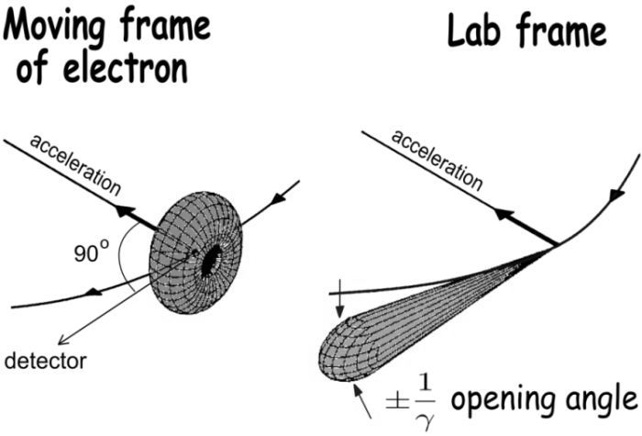
Generation of synchrotron radiation matches for Einstein's thought experiment exactly!
Moving frame of electron → „system of co-ordinates (x, y, z)”
Lab frame → „system of co-ordinates (ξ, η, ζ)”
Image from http://photon-science.desy.de/research/studentsteaching/primers/synchrotron_radiation/

Slide 5
But Einstein's assumption: „Meanwhile the body remains at rest with respect to the system (x, y, z).” – is wrong! Because the electrons are decelerated by the radiation!

Slide 6
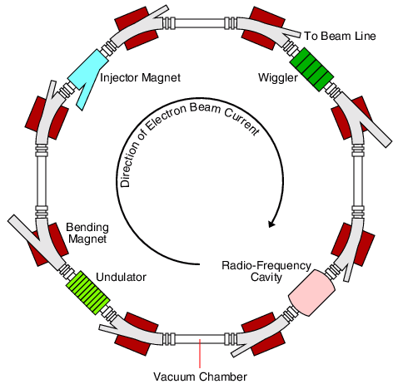
How do Synchrotrons Work? http://pd.chem.ucl.ac.uk/pdnn/inst2/work.htm
„… a radio-frequency generator/cavity, of which there could be several around the ring. The purpose of this device is to synchronously (hence the name synchrotron) feed energy to the electron bunches circulating in the ring to compensate for their energy losses during their emission of radiation.”

Slide 7
Therefore, during the emission of radiation in the reference system (x, y, z) – „Moving frame of electron” – the electrons will be accelerated opposite to the direction of motion. Conclusion: Einstein's principle of relativity fails!

Slide 8
Had Einstein been right…
the electrons would not need any additional acceleration in the storage ring, the radiation would go at the expense of the mass.
The electrons radiated and radiated until their mass entirely consumed and they eventually disappeared...
Because they have a charge, these would disappear with them, so even the charge conservation law would be violated.

Slide 9
Obviously, the reference systems (x, y, z) and (ξ, η, ζ) are not with equal rights.
In reality, the reference system of the accelerator is crucial, it determines the shape and intensity of the radiation and the behavior of the electrons.
The other reference systems are simply observing systems and irrelevant to the real processes.

